Slide 2
The missing link: How to implement a (lasting) 24/7 context that promotes psychological flexibility
Trym N. Jacobsen
ACT&BET Instituttet

Slide 3
About our work
Collaboration formed out of common interrest and experiences over the last 7 years
3 different psychiatric wards in Norway
3 psychologists, 1 nurse
2012: started ACT&BET Institute
2014: presented implementation model at ACBS world con in Minneapolis
2014-2015: using model to implement BET from scratch at external hospital ward

Slide 4
 | MONDAY | TUESDAY | WEDNESDAY | THURSDAY | FRIDAY
07.00-07.15 | Report night/day | Report night/day | Report night/day | Report night/day | Report night/day
08.00-08.10 | Joint meeting G.1/2 Focus last week - Focus this week - Process evaluation | Group report | Group report | Group report | Group report
08.10-08.45 |  | Reflecting team: System / ethics | Reflecting team: System / ethics | Reflecting team: Clinical coordinator’s meeting | Process evaluation: Focus this week New focus next week
08.45-08.55 | Practical: sessions, info, coaching | Practical: sessions, info, coaching | Practical: sessions, info, coaching | Practical: sessions, info, coaching | Practical: sessions, info, coaching
08.55-09.00 | A1-A2 Coordinate | A1-A2 Coordinate | A1-A2 Coordinate | A1-A2 Coordinate | A1-A2 Coordinate
09.00-09.30 | Focus sessions | Focus sessions | Focus sessions | Focus sessions | Focus sessions
09.30-09.50 | Morning meeting cl. | Morning meeting cl. | Morning meeting cl. | Morning meeting cl. | Morning meeting cl.
09.50-10.30 | Physical activity | Physical activity | Physical activity | Physical activity | Physical activity
10.30-11.30 | Psych ed group - 11.15 | Therapy client A and B | Therapy client C and D | Therapy client E and F | Therapy client A and B
11.30-12.00 | LUNCH | LUNCH | LUNCH | LUNCH | WEEK END LUNCH
12.00-12.45 | Therapy cl. A, B and C | Therapy cl. E and F | Therapy cl. A and B | Therapy cl. C and D | Therapy cl. E and F
12.45-13.30 | Therapy cl. D, E and F | Therapy cl. C and D | Therapy cl. E and F | Therapy cl. A and B | Therapy cl. C and D
13.45-14.30 | Group supervision role-play | Treatment planning: Refl team with client | Group supervision role-play | Treatment planning: Refl team with client | Group supervision role-play
14.30-15.00 | Cl. team-coordination | Coordination refl team | Cl. team-coordination | Coordination refl team | Cl. team-coordination
15.00-15.20 | Group ind report | Group ind report | Group ind report | Group ind report | Report gr1 gr2
15.20-15.30 | A1-A2 Coordination | A1-A2 Coordination | A1-A2 Coordination | A1-A2 Coordination | A1-A2 Coordination
16.00-16.15 | Afternoon meeting | Afternoon meeting | Afternoon meeting | Afternoon meeting | Afternoon meeting
16.15-16.45 | Focus sessions | Focus sessions | Focus sessions | Focus sessions | Focus sessions
1700-20.00 | Milieu therapist sessions when needed | Milieu therapist sessions when needed | Milieu therapist sessions when needed | Milieu therapist sessions when needed | Milieu therapist sessions when needed
21.15-21.30 | Report evening/night | Report evening/night | Report evening/night | Report evening/night | Report evening/night
Reflecting team
system/ ethics
Reflecting team
system/ ethics
Reflecting team:
Clinical coordinator’s meeting
Group supervision
role play
Treatment planning:
Refl team with client
Group supervision
role play
Treatment planning:
Refl team with client
Group supervision
role play
Cl Reflecting team
Cl Reflecting team
Cl Reflecting team
Cl Reflecting team
Cl Reflecting team

Slide 5
Functional Model of Implementation
Current Context
…Chosen
Goals and Values
Management
Procedures
Staff Procedures
Committed Actions
Changing Organizational Culture in Direction of …
Notes:
The truth about the quality of the conducted implementation process is the degree of committed actions, compatible and supporting chosen goals and values, connected to methodology in focus.
The implementation process is structured in two circles, management level and employee level.
Current context is the influenced by the remaining former organizational culture and the new culture elements actually presented and implemented, influenced by hidden and chosen goals and values.

Slide 6
Integrating Ostrom`s 8 Principles
Integrating Ostrom’s 8 principles (+ 9-10)

Slide 7
Future work:
The BET and ACT ward at Blakstad
Getting the foot in the door to use the implementation model at other wards:
1 year training program for inpatient ward therapists (starting with psychiatrists and psychologists
Theoretical and data-driven publications

Slide 8
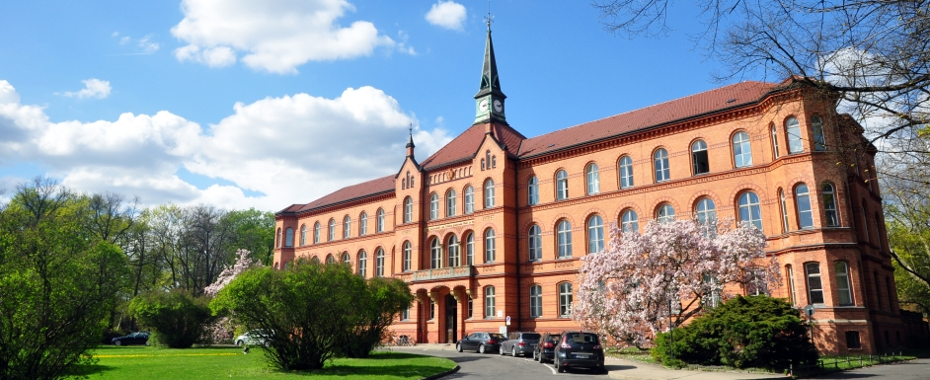
Head of department:
Prof. Albert Diefenbacher
ACT implemented:
Psychiatric inpatient ward
Psychosomatic day clinic
Psychiatric outpatient clinic

Slide 9
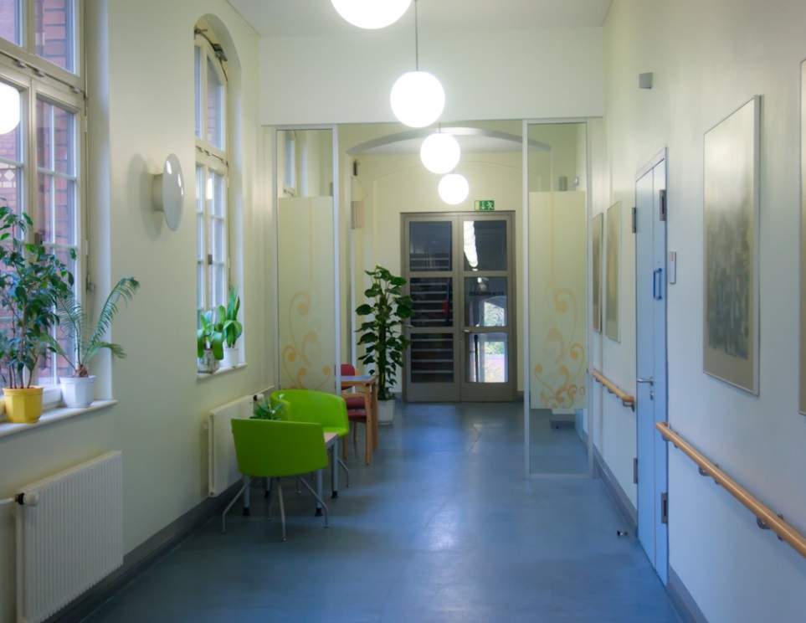
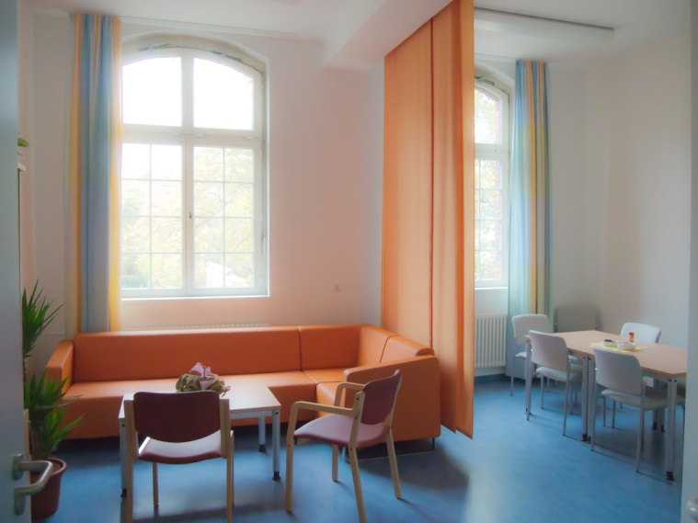
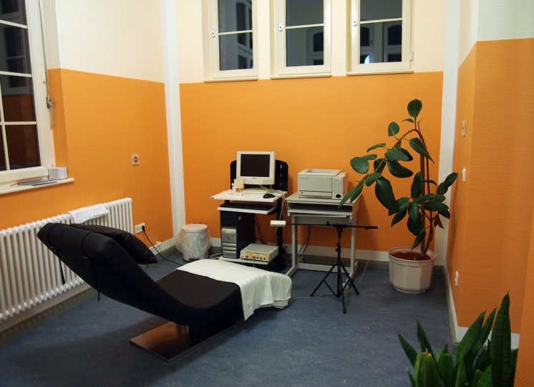
P09: Ward for Mood Disorders and Comorbid Disorders

Slide 10
Implementing ACT on the Ward for Mood Disorders (P09)
Since 2012
2010
2011
IPT
CBT
ACT
ACT literature
ACT Workshops
Decision to implement ACT in different settings
ACT
Curriculum
(in-house trainings)

Slide 11
ACT in an inter-disciplinary Setting
ACT group sessions: twice/week
Mindfulness training
ACT core processes
ACT and occupational therapy:
Mindfulness training
Creative implementation of ACT core processes
ACT and physiotherapy:
Body focused Mindfulness training
Yoga, Pilates, Qigong

Slide 12
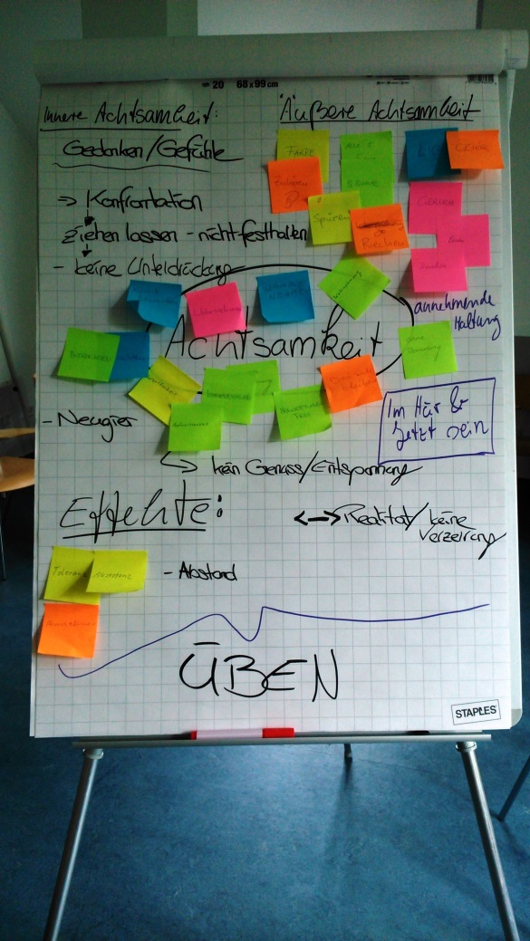
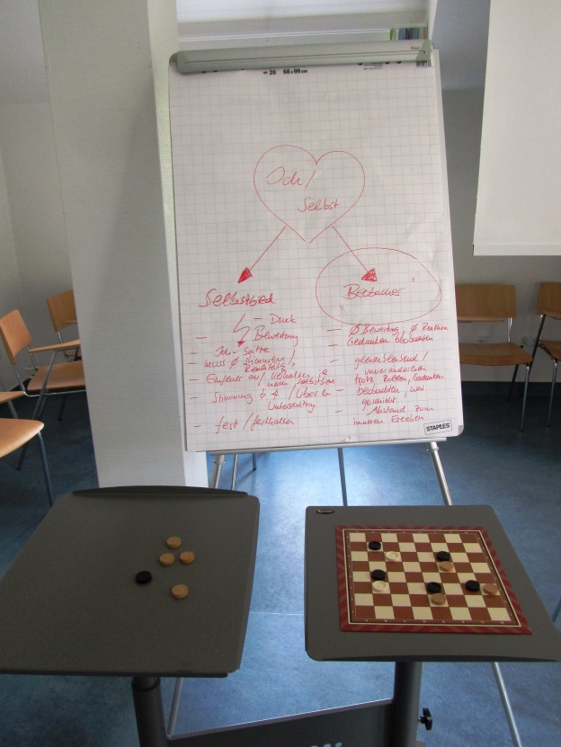
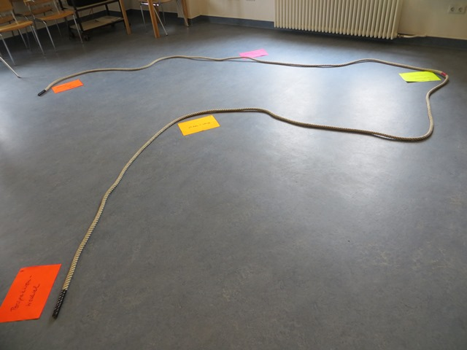
ACT group sessions

Slide 13
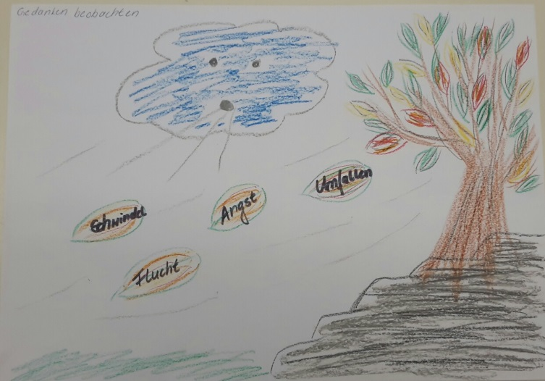
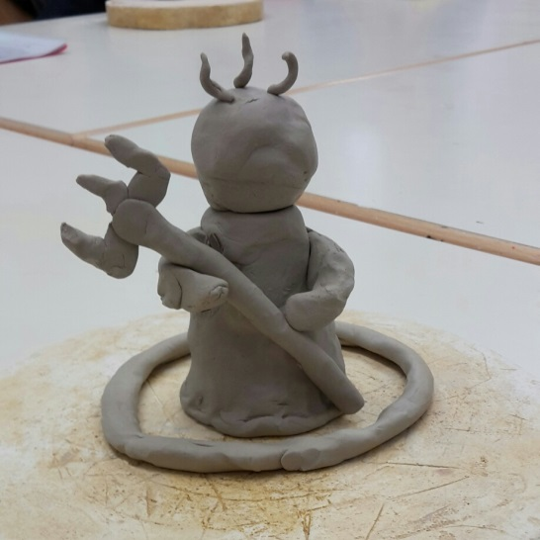
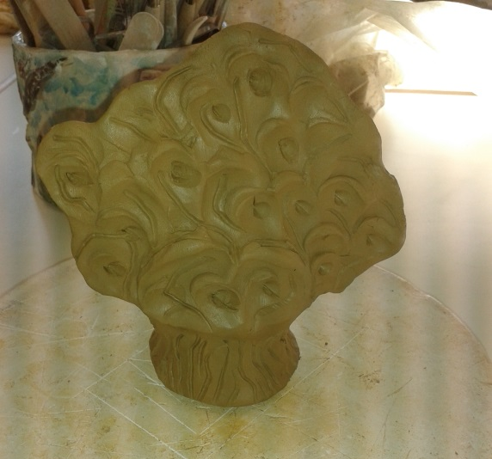
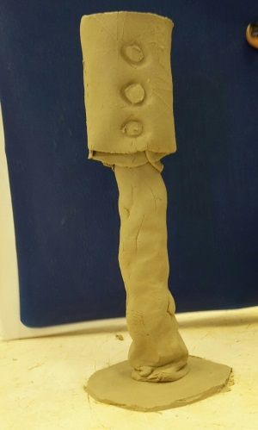
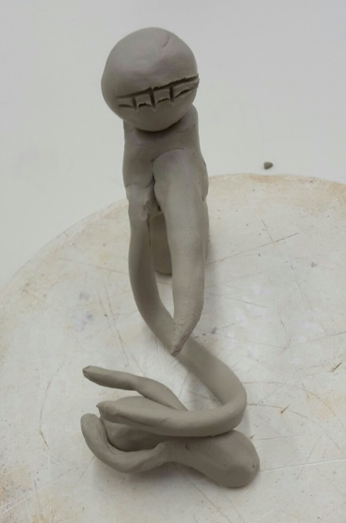
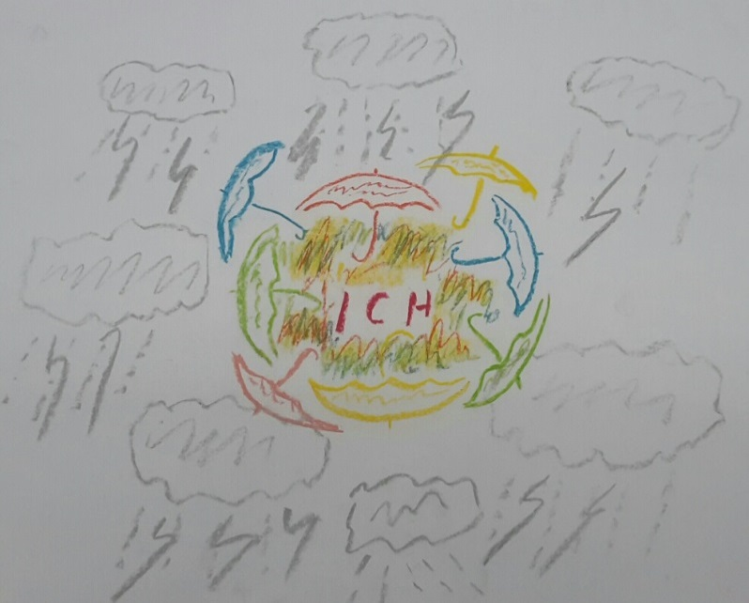
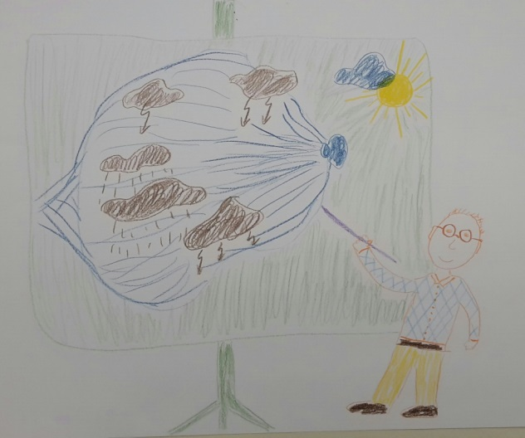
ACT and occupational therapy

Slide 14
Legato: centre for psychotic disorders

Slide 15
Legato: centre for psychotic disorders
Admission Ward
for the
Rehabilitation Unit
2010
Admission Ward
For the
Psychosis Unit
General population
Psychosis – Bipolar - …
Rehabilitation
Recovery
CBT
ACT

Slide 16
Implementation process
Workshop
ACT with Psychosis
Asster
exchange
Symposium
ACT/Recovery
Exchange
Exchange
Exchange
In company
training
Workshop
defusion
Leonardo
Life Long
Learning
Workshop
addiction
Evaluation
changes
Super/inter
vision
Resources
The Thought
The Break
ACT-MDT
The Step
ImpACT
ACT - P
The Compass
MF
GP
Largo ACT
VDIP
2010
2011
2012
2013
2014
2015

Slide 17
Attentiontraining & Mindfulness
The Compass
The Thought
(ImpACT)
The Break
The Step

Slide 19
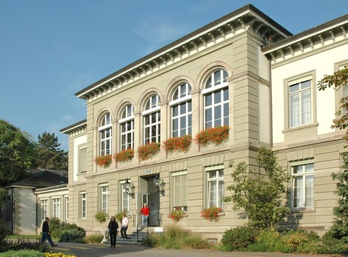
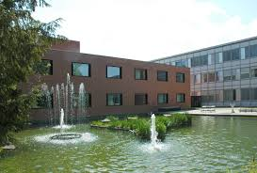
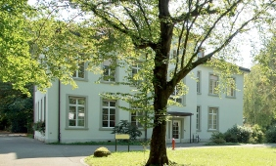
Universitäre Psychiatrische Kliniken Basel:
∼ 600 beds (Inpatient setting)
3 centers (Adults, Childs, Forensic)
In- and Outpatient settings
15 Inpatient Units for adults
The Behavioral Psychotherapy Inpatient Unit → entirely ACT-based
ACT-based Unit VTS:
Since 2012
Inpatient setting
16 patients

Slide 20
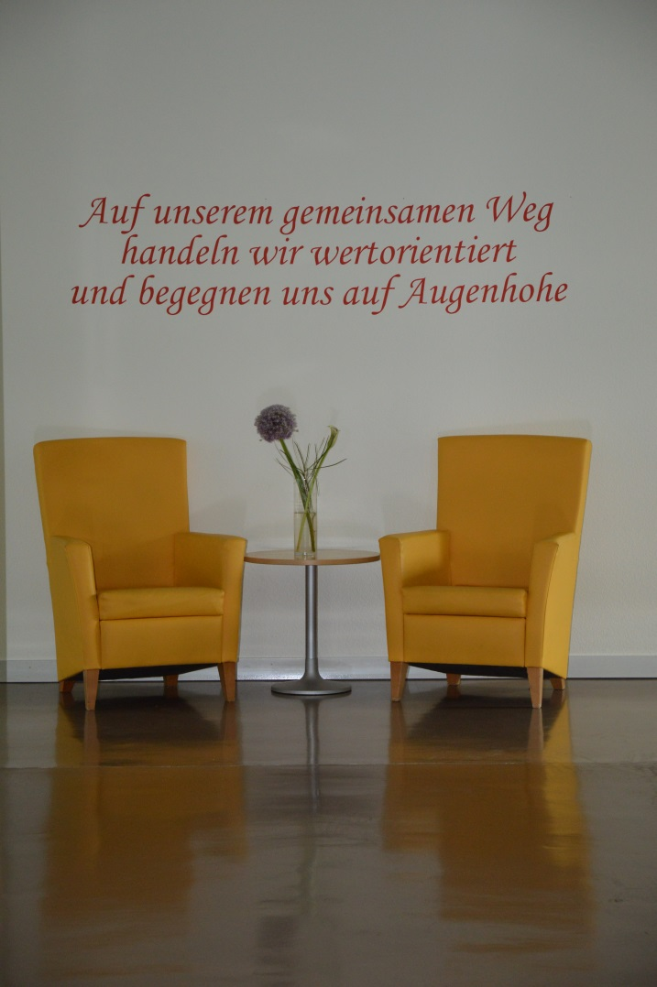
ACT-based inpatient Unit VTS:
100 % ACT-based psychotherapy
Inpatient Setting, 6 to 12 weeks
Specialized for treatment-resistant and chronic mental disorders
F3: mood (affective) disorders
F4: neurotic, stress-related and somatoform disorders (e.g. anxiety disorders, OCD)
F5: behavioral syndromes associated with psychological disturbances and physical factors

Slide 21
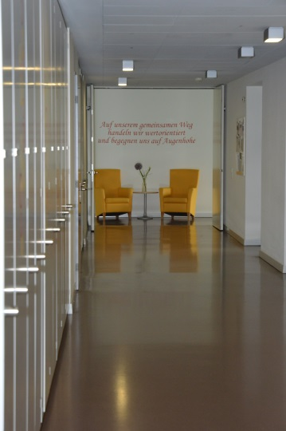
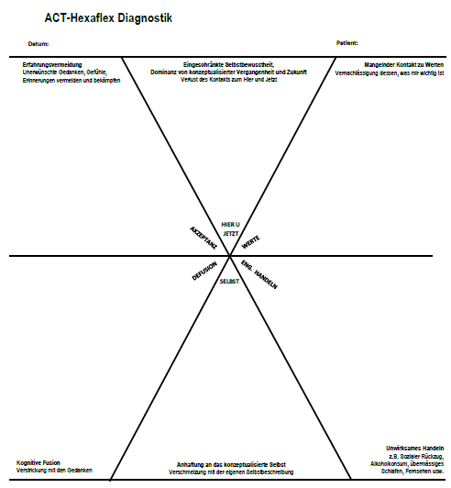
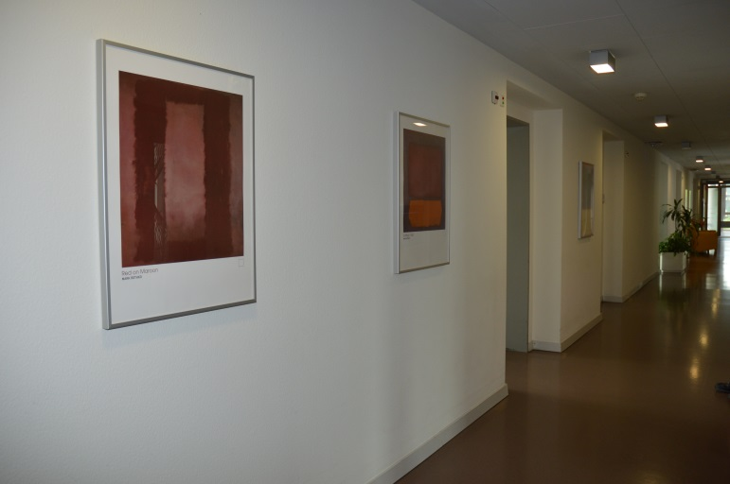
ACT-based inpatient Unit VTS:
All staff members are ACT-trained
(psychological psychotherapists, medical doctors/psychiatrists, nursing staff, occupational therapists, social workers, physiotherapists, …)
Diagnostic classification, team-reporting and treatment planning is entirely ACT-based

Slide 22
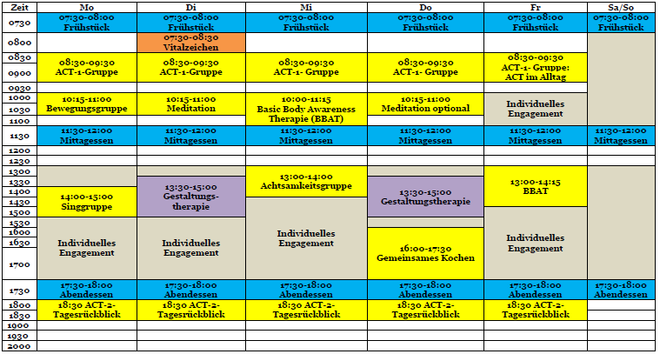

Slide 23
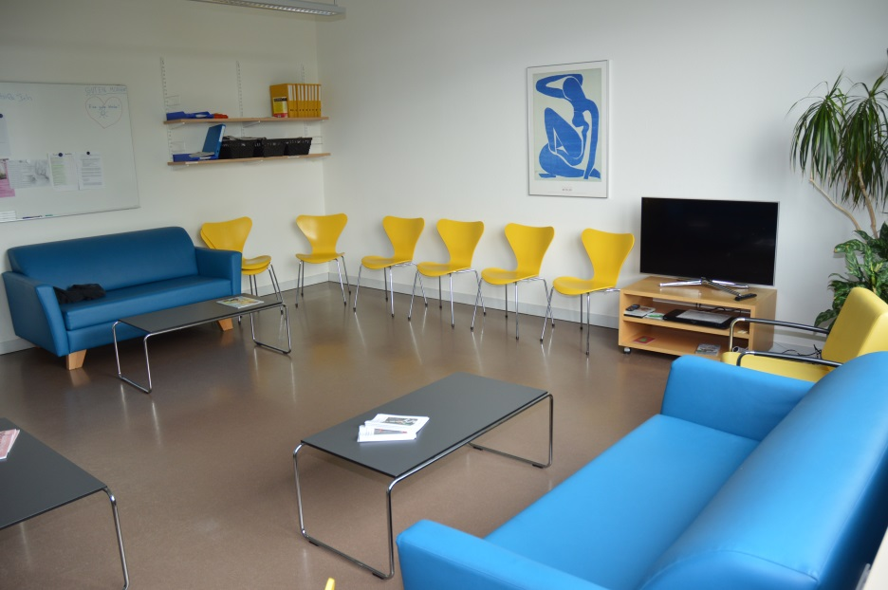
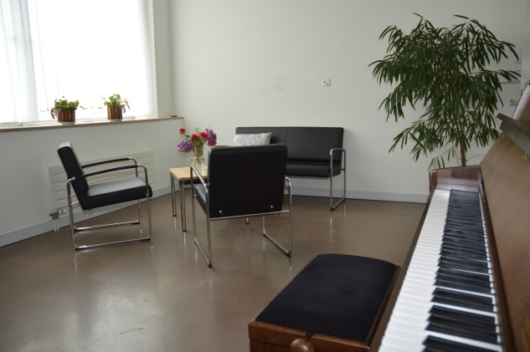
Group-Therapy at the VTS:
Daily
1 hour in the morning
30 min repeating in the evening
Starting with being present/ mindfulness exercise
Topic week 1: Acceptance
Topic week 2: Values & committed action
Topic week 3: Cognitive Defusion
Topic week 4: Self as Context
Individual Therapy at the VTS:
Twice a week with psychological psychotherapist
Daily contact with nursing staff
Once a week longer therapeutic contact with nursing staff

Slide 24
ACT at inpatient clinics in Västerås and Stockholm, Sweden
Tobias Lundgren et al
Karolinska Institute, Department of Clinical Neuroscience & Centre for Psychiatry Research and Education, Stockholm County Council
Psychology department, University of Stockholm

Slide 25
Aim
Implement psychological treatments early, preferably at intake.
Lack of psychological treatments
Lower suffering and increase valued activities for both staff and patients with multi problems.
Implement effective ways of speaking broadly in psychiatric settings.

Slide 26
What we have done so far…
Bach and Hayes, Guadiano etc etc.
A pilot RCT (My Ph.D student Mårten Tyrberg will present it during our symposium)
Show effects, however a small study.
What we do now in Västerås is to train staff to do ACT consciously during their work
Measure amount of “ACT talk” delivered by staff every two hours during work day.
Measure effects on patients valued living and symptoms
Do a larger RCT where hand picked staff will perform the develop ACT manual with the service of “floor workers”. Every one under supervision and measure the effects.

Slide 27
Coming years…
Received a large grant to implement a similar but larger intervention at clinics in Stockholm.
We are starting with a pilot clinic. Educating all staff in ACT through ACT workshops and supervision
We are developing a manual where we combine ACT, MI and BA.
Manual with different blocks. Therapists conduct individual analysis and chose interventions from the different blocks from the manual.
Starting the intervention early when patients are signed in.
Often patients are signed in, get medication, rest (?) and are signed out.
Will have a psychologist at each clinic to run the program at the specific clinic, however, as said, all staff will be trained and included in the treatment.
When the treatment is effective we introduce it at all units in Stockholm.

Slide 28
Some of the outcome measures
Patients
Decrease patient time at the inward clinic and increase time for “reintake”
Increase valued activities from patients
Decrease use of “in need medication”
Increase medication adherence
Staff
Increase ACT consistent behaviors
Increase work satisfaction
Decrease sick leave

Slide 29
Topic 1: implementation
Who chose for implementing ACT on the ward?
What kind of implementation-process did you use and what experiences did this bring forward?
What worked in the implementation? What didn’t?
How does the ACT approach sit aside other models of care? (including a symptom elimination/ medical model) Does the pragmatism of a contextual approach add anything to “standard care” in a psychiatric setting?

Slide 30
Topic 2: team-approach
What’s the role of the different disciplines/staff-members in the ACT-story? Who was trained and how does the teamwork look like?
How is the team supervised? What experiences do you have where ACT-oriented supervision was particularly useful, and where it wasn’t?
How do you ensure that it is ACT/ CBS being offered? Do you measure adherence and competence? How do you approach the quality assurance of the interventions

Slide 31
Topic 3: clients
How do clients react since ACT has been implemented in comparison with no ACT on the ward?
How are sessions shaped (open – closed) and how do clients react?
Are families/spouses/significant others involved and how?
Do you involve clients/ service users in designing and evaluating the service? Is there co-production of materials? What involvement is there from “experts by experience” ?
For those who are compelled to have treatment, can you give examples of how the ACT approach may be useful? where this is not successful?

Slide 32
Topic 4: pathways
What do you say about ACT to professionals who you are working with (GP’s, psychiatrists,…)?
What happens before and after their stay at the ward, ACT-wise?

Slide 33
Topic 5: outcome
What scales/questionnaires/… do you use in monitoring behavior change?
Who is part of the assessment (team – client – family -…)?

